Slide 1
Lecture 8
JavaScript

Slide 2
Today’s lecture
What are functions?
How to define functions?

Slide 3
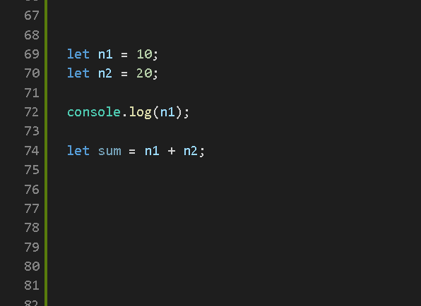
Understanding code execution

Slide 4
Understanding code execution

Slide 5
Understanding code execution

Slide 6
Understanding code execution

Slide 7
Functions
A piece or block of code which can be execute on demand.
Functions are way to label our code and execute the code by recalling our label.
They allow us to re-use that piece of code again and again.
We can also provide input and demand output from our functions.

Slide 8
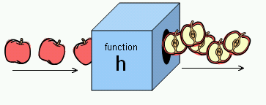
INPUTS (PARAMETERS)
OUTPUT (RETURNED )

Slide 9
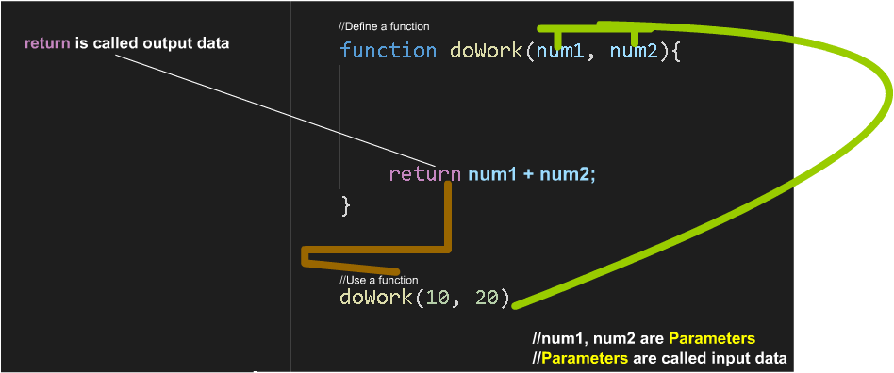

Slide 10
Understanding code execution

Slide 11
Calling JavaScript in different ways
<button onclick=“alert(this.id)” id=“myID”></button>
<button onclick=“this.style.color=‘green’” id=“myID”></button>

Slide 12
Passing Function Parameters
<button id=“one” onclick=“myfunction(this.id)” button>
function myFunction(data){ //data is one }

Slide 13
Adding effects with events
<button id=“one” onmouseover=“this.style.backgroundColor = red” onmouseout=“this.style.backgroundColor= buttonface”><button>
<img src=“cat.jpg”
onmouseover=“this.src = ‘cata.jpg’” onmouseout=“this.src = ‘cat.jpg’” />

Slide 14
CSS and JavaScript Meets!
We can use CSS properties in JavaScript as long as we follow the variable rules for JavaScript
Example>
CSS > background-color
JavaScript > backgroundColor
CSS > border-radius
JavaScript > borderRadius

Slide 15
Forms
Forms, as the name suggests, is simple a collection of different kind of fields.
<form id=“myForm” onSubmit=“validate()” action=“/save”>
<input id=“name” type=“text” />
<input id=“password” type=“password” />
<button type=“submit”>Submit</button>
</form>

Slide 16
Forms
function validate(){
if(!myForm.name.value || !myForm.password.value){
alert(‘Please fill the complete form’);
event.preventDefault();
}
}

Slide 17
Forms Fields
Every form element which has a value attribute, its value can be accessed or reset in JavaScript through .value syntax
Example>
<input type =“text” />
And all other input elements
<select> <option value=“one”></option> <option value=“two”></option>
<option value=“three”></option>
</select>

Slide 18
Getting and setting field states
Each form field’s can also be altered with their special properties.
<input id=“one” type=“checkbox” />
or
<input id=“one” type=“radio” />
var m1 = document.getElementById(‘one’);
m1.checked = true; m1.checked = false;

Slide 19
Setting Field Values via attributes
<input checked id=“one” type=“checkbox />
<input checked id=“two” type=“radio” />

Slide 20
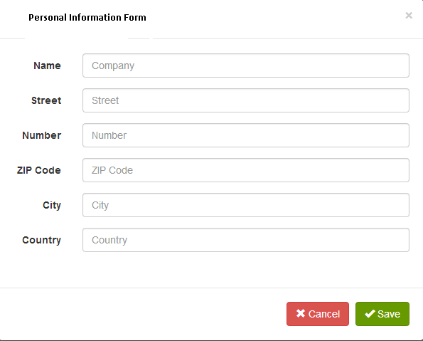
Today’s Assignment
Next Lecture 1). Manipulating i.e. appending , removing, changing content of other HTML elements, p, div. header
Hint> Number(‘your specified number’) will return Truthy or Falsy.

